Slide 1
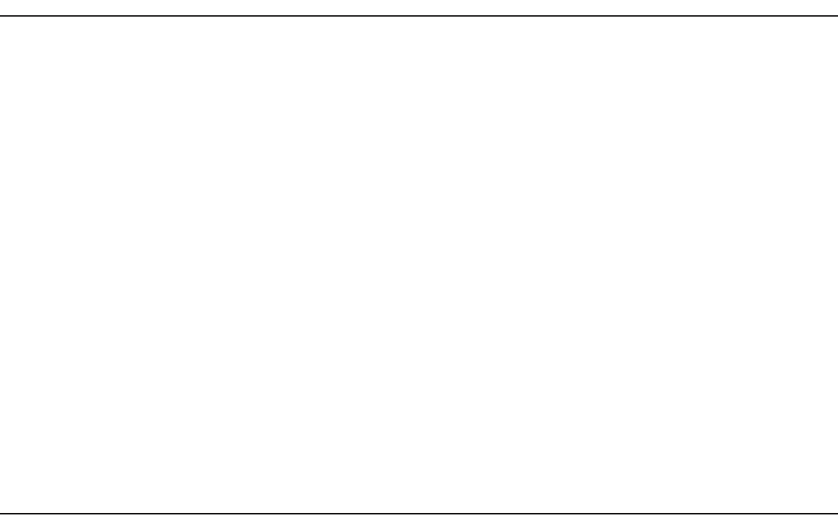
Hymn #563
“Jesus, Thy Blood and Righteousness”

Slide 2
1. Jesus, Thy blood and righteousness
My beauty are, my glorious dress;
Midst flaming worlds, in these arrayed,
With joy shall I lift up my head.

Slide 3
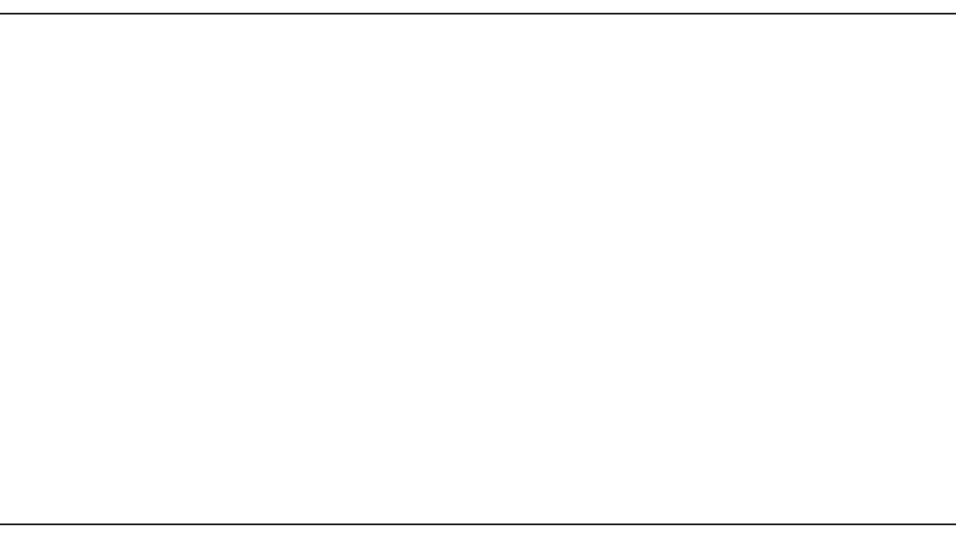
2. Bold shall I stand in that great day,
Cleansed and redeemed, no debt to pay;
Fully absolved through these I am
From sin and fear, from guilt and shame.

Slide 4
3. Lord, I believe Thy precious blood,
Which at the mercy seat of God
Pleads for the captives’ liberty,
Was also shed in love for me.

Slide 5
4. Lord, I believe, were sinners more
Than sands upon the ocean shore,
Thou hast for all a ransom paid,
For all a full atonement made.

Slide 6
5. When from the dust of death I rise
To claim my mansion in the skies,
This then shall be my only plea:
Jesus hath lived and died for me.

Slide 7
6. Jesus, be endless praise to Thee,
Whose boundless mercy hath for me,
For me, and all Thy hands have made,
An everlasting ransom paid.
Public domain

